Slide 1
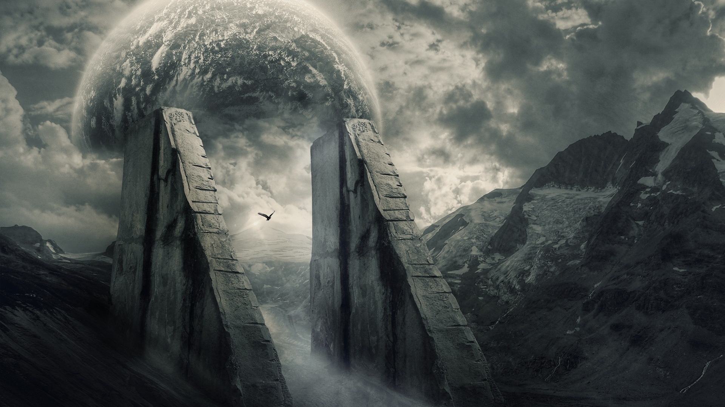
Blade of the Lost: The Silent Survivor Progress Report 1:
Developers: Josef Bacík (312553801) and Eduin Hernandez (艾德文 - 0860828)
Group #19
Instructor: 黃世強
https://wallpapersafari.com/w/Ppzkj5

Slide 2
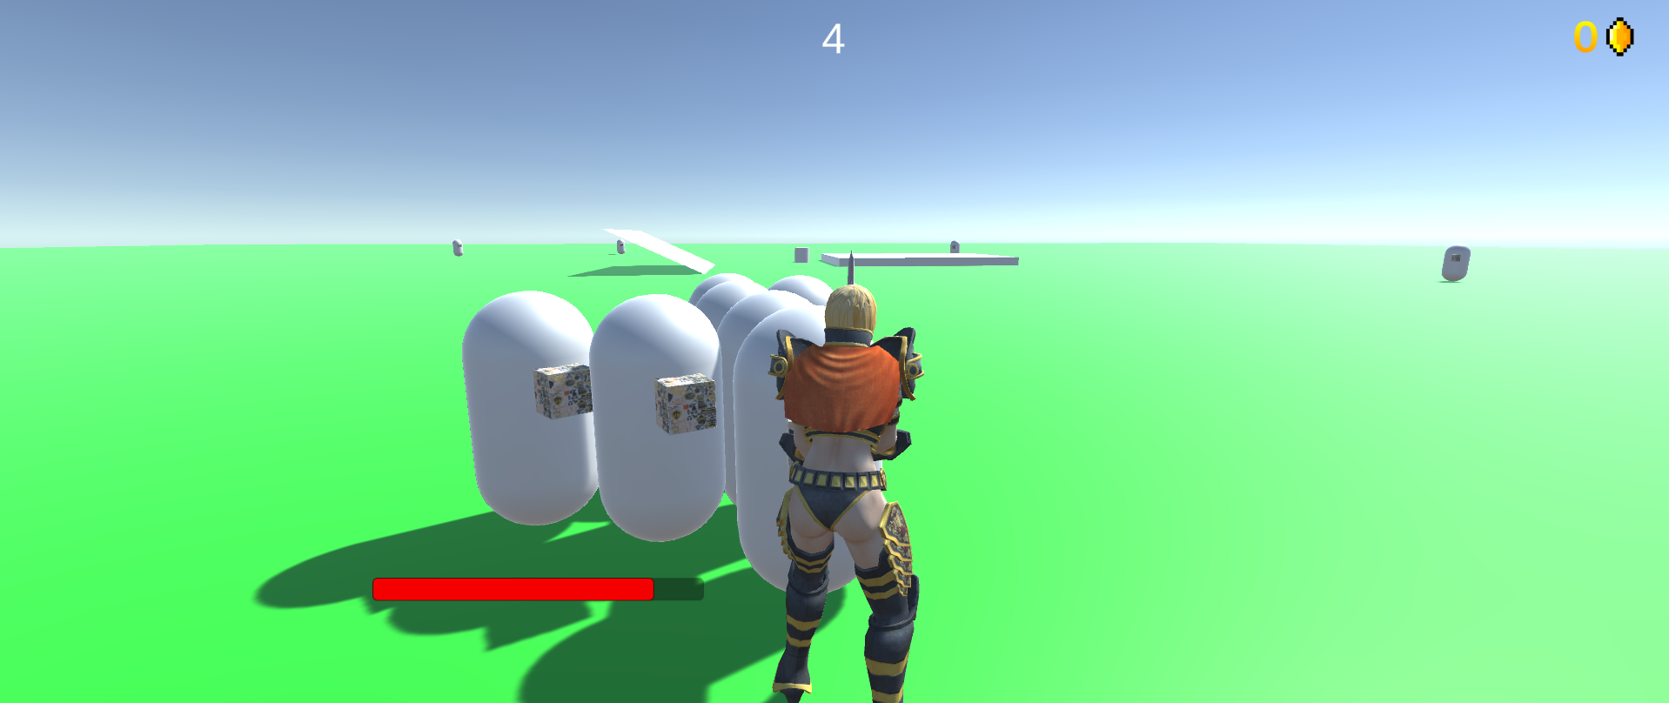
Basic test scene
Unity Prefab preparation
Code testing and connecting
Simple environment
If this would become the main scene, we may forget to remove some testing features from it
Test scene with player and 2 enemies

Slide 3
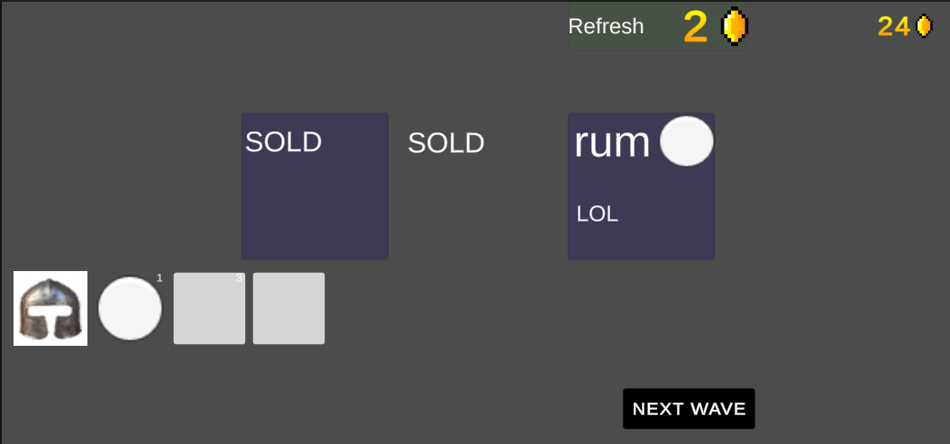
Inventory system
Shop
On button click – buy loaded item
Insert in inventory – singleton
On insert – invokes an event

Slide 4
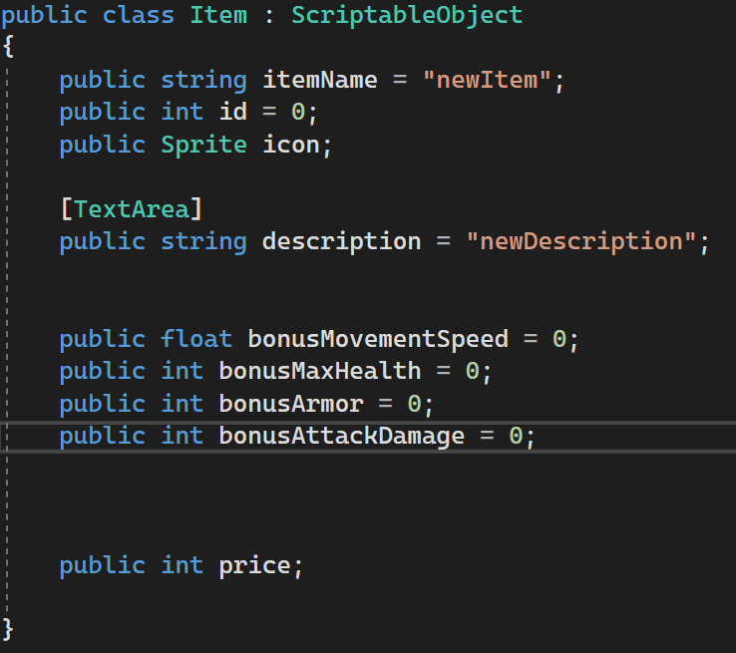
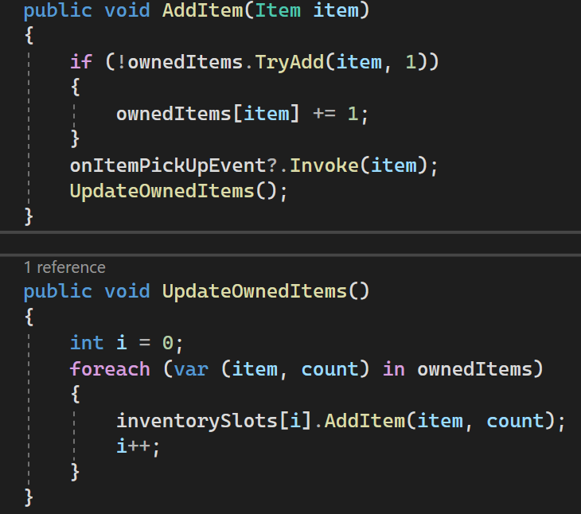
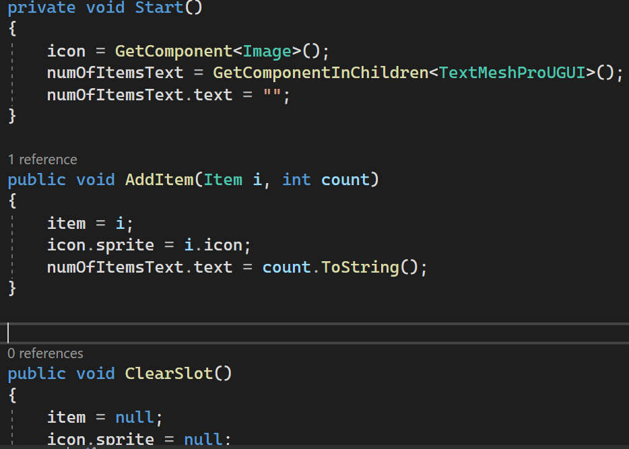
Part of Inventory manager
Item SO
Inventory slot

Slide 5
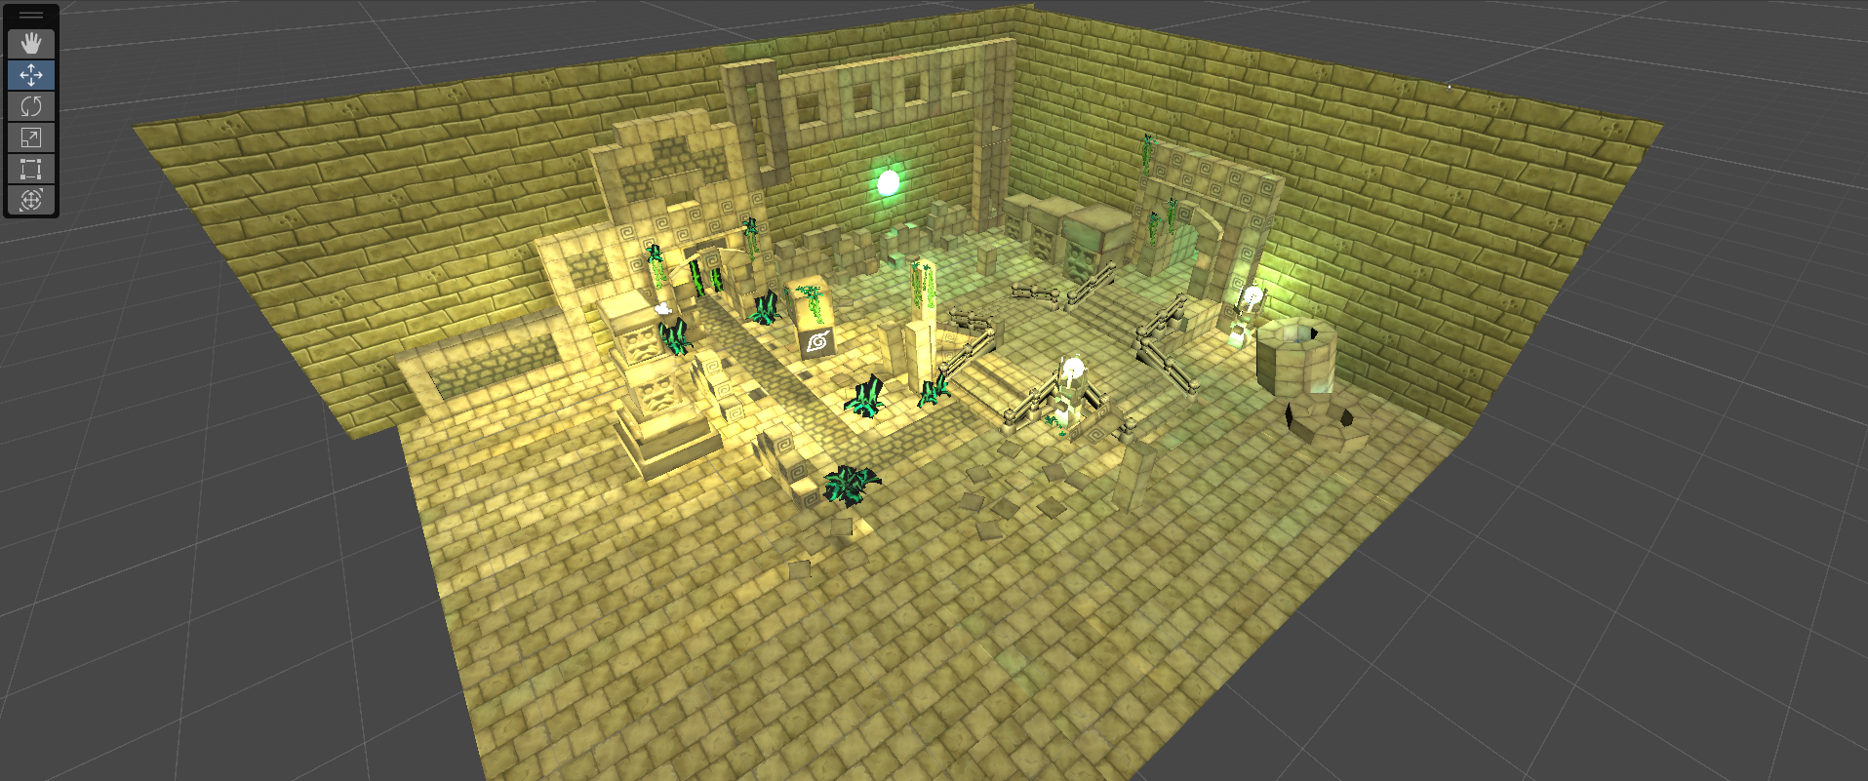
Arena design
Make a simple but pretty arena(s)
Use point light sources to light up the arena
Do not create too many obstacles, since it is not the main part of an endless horde game
Preset from the downloaded asset

Slide 6
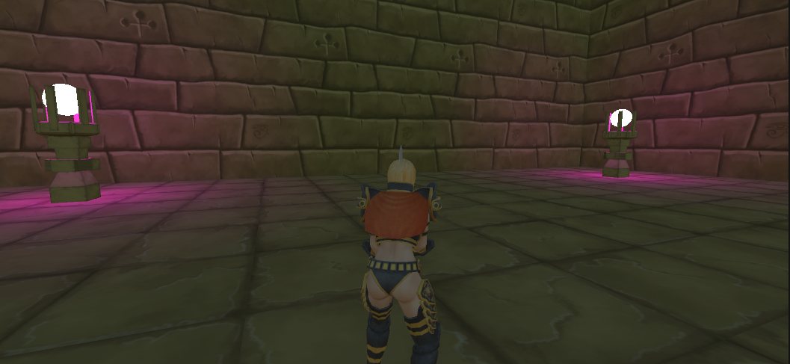
Arena design – Level 1?

Slide 7
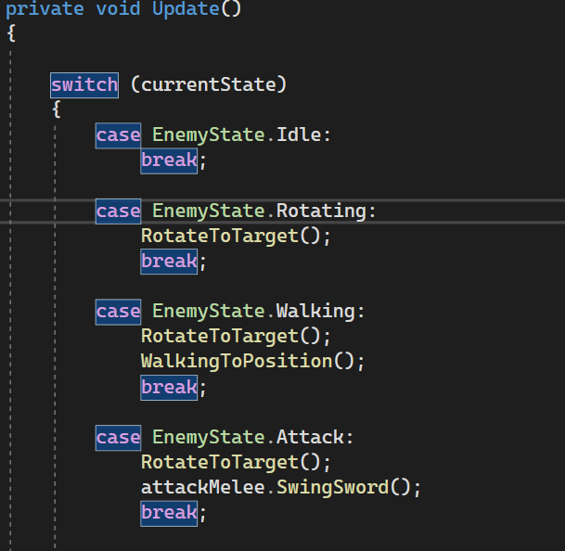
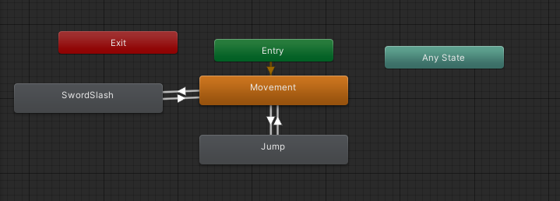
Other implemented Features
Basic enemy – just walk toward player if close
Basic player animations – still WIP, not seamless transitions
Coin system for shop (drops from enemy)

Slide 8


Next steps
Add another enemy AI
Wave system
Finish arena(s)
Add more item variations and sprites
Enemy models
Enemy and player animations
Add more Player stats
Add Sounds

Slide 9
THANK YOU!

